Slide 1
Лабораторна робота №7/8
Піт-15-3
Чолія Михайла

Slide 2
Design tests applying test design techniques
Мета:
Навчитись проектувати тести використовуючи техніки тест дизайну.
Завдання:
Design tests applying test design techniques
Create Test Cases for all designed tests

Slide 3
Variant 2
Equivalence partitioning and Boundary value analysis
To have ability to buy products on web store user should register his login name on web registration page. The field for entering login name should:
contain letters only
to be no shorter than 4 characters
to be no longer than 10 characters.
Login names which do not meet requirements will not be allowed.
Build equivalence classes (partitions) based on given information
Stand Out boundary values

Slide 4
Decision tables and State transition
Decision tables
If you are a new customer opening a credit card account, you will get a 15% discount on all your purchases today. If you are an existing customer and you hold a loyalty card, you get a 10% discount. If you have a coupon, you can get 20% off today (but it can't be used with the 'new customer' discount).
Build decision table based on given information
Cover requirements above by tests (write test cases’ names and objectives) based on decision table analysis
State transition
User tops his friend’s mobile account using sending money option. He enters amount of money he likes to send, types mobile number and click ‘Send’. If entered amount of money is allowed and phone number format is correct, then money will be sent and user will get appropriate message. If sum of replenishment is too low or too high, then user should re-enter it. If phone number format is incorrect, then user should enter correct phone number.
Build state transition diagram based on given information

Slide 5
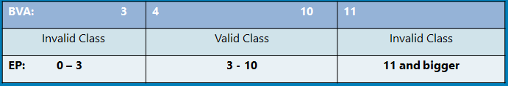
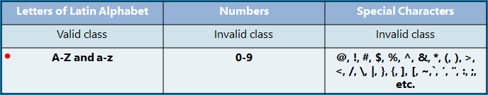
Equivalence partitioning and Boundary value analysis

Slide 6
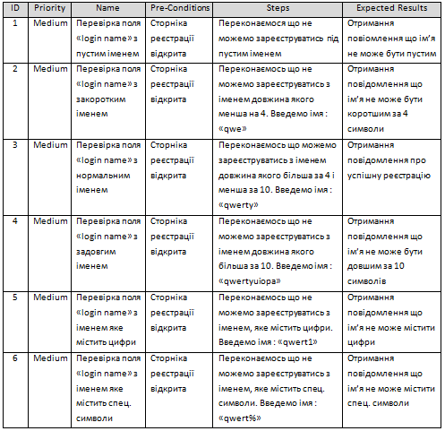

Slide 7
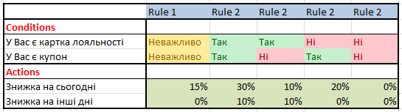
Decision tables
Rule 1: Ви новий замовник
Rule 2: Ви не новий замовник

Slide 8
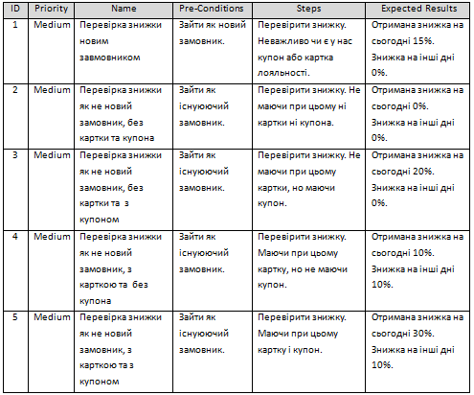

Slide 9
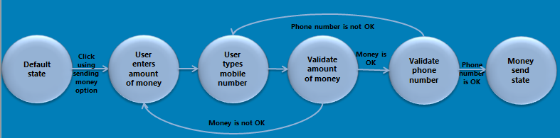
State transition

Slide 10
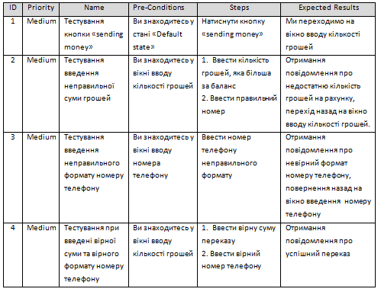

Slide 11
Висновок
В ході виконання даної лабораторної роботи було виконано тести з використанням технік дизайну і створено тест-кейси до цих тестів.

